Slide 1
Face Mask Detector
Deep Learning_Final Projet
109368021_侯秀玲
109368085_臧英宏
109368086_李冠叡

Slide 2
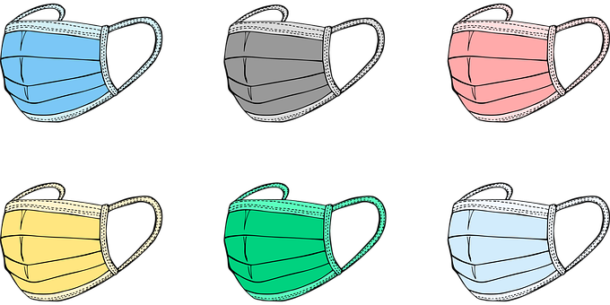
Outline
Model using
Flowchart
Dataset
Structure
Demo
Suggestions for improvement
Summary
References

Slide 3
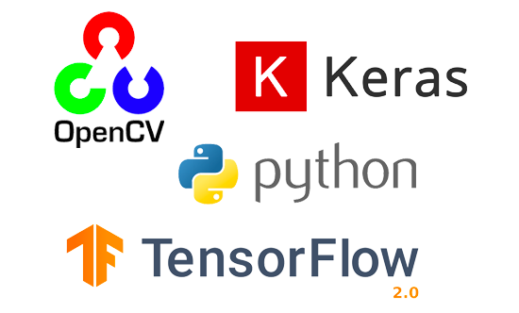
Training a model using：
Python (3.6.9)
Keras (2.4.3)
TensorFlow (2.4.0)
OpenCV (4.1.2)

Slide 4
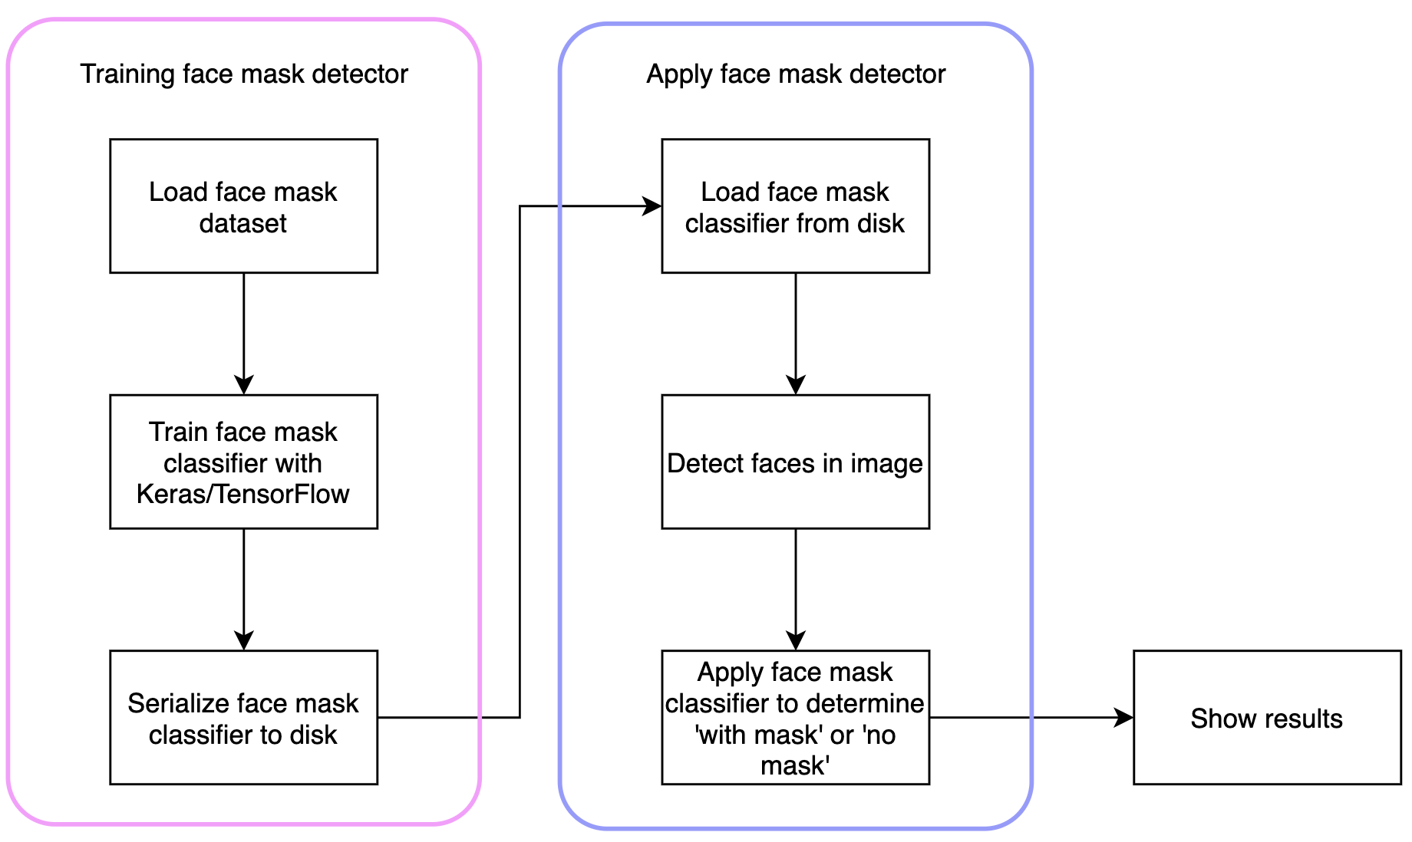
Flowchart

Slide 5
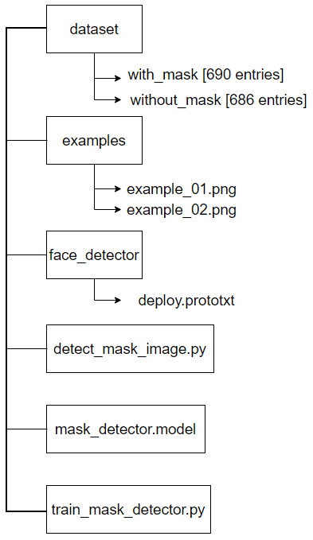
Project structure

Slide 6
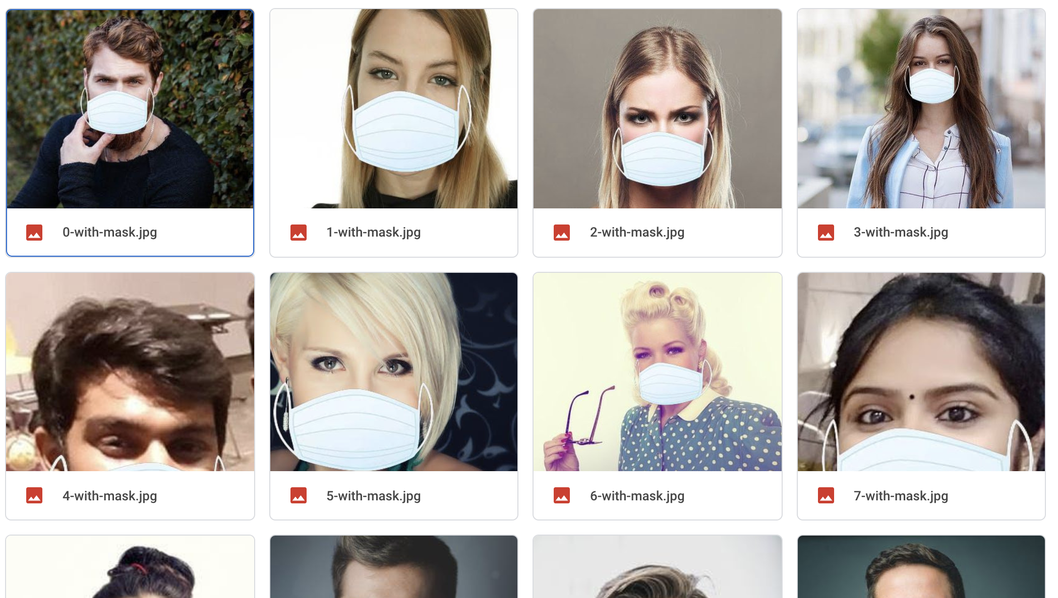
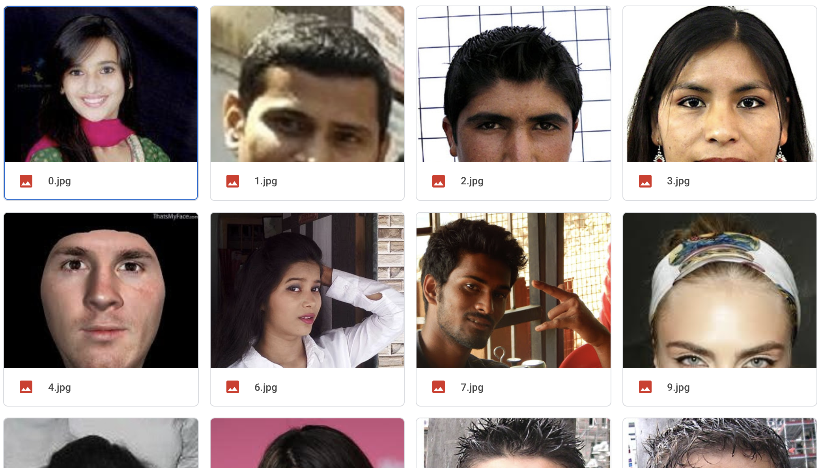
Face mask detection dataset
with_mask：690 images
without_mask：686 images
Notes:
A face mask detection dataset consists of “with mask” and “without mask” images. We will use the dataset to build a face mask detector with computer vision and deep learning using Python, OpenCV, and TensorFlow/Keras.
The dataset we’ll be using here today was created by PyImageSearch reader Prajna Bhandary.
This dataset consists of 1,376 images belonging to two classes:
How was our face mask dataset created?
It has been feeling down and depressed about the state of the world — thousands of people are dying each day, and for many of us, there is very little (if anything) we can do.
Decided to applying computer vision and deep learning to solve a real-world problem:
Best case scenario — we could use her project to help others
Worst case scenario — it gave her a much needed mental escape

Slide 7

We detect facial landmarks using dlib so that we know where to place a mask on the face
Eyes
Eyebrows
Nose
Mouth
Jawline
ROI（Region of interest)
Notes:
Facial landmarks allow us to automatically infer the location of facial structures, including:
Eyes
Eyebrows
Nose
Mouth
Jawline
To use facial landmarks to build a dataset of faces wearing face masks, we need to first start with an image of a person not wearing a face mask:
From there, we apply face detection to compute the bounding box location of the face in the image:
The next step is to apply face detection. Here we’ve used a deep learning method to perform face detection with OpenCV.
Once we know where in the image the face is, we can extract the face Region of Interest (ROI).
Next, we need an image of a mask (with a transparent background).

Slide 8
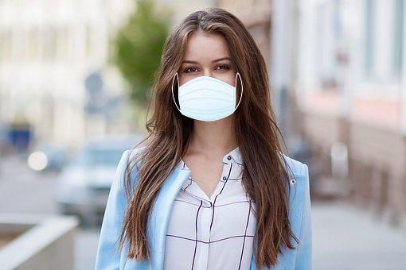
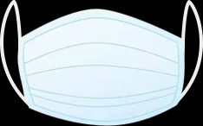
We need an image of a mask (with a transparent background) such as the one below:
This mask will be automatically applied to the face by using the facial landmarks (namely the points along the chin and nose) to compute where the mask will be placed.
The mask is then resized and rotated, placing it on the face:
Notes:
In this figure, the face mask is placed on the person’s face in the original frame. It is difficult to tell at a glance that the mask has been applied with computer vision by way of OpenCV and dlib face landmarks.

Slide 9
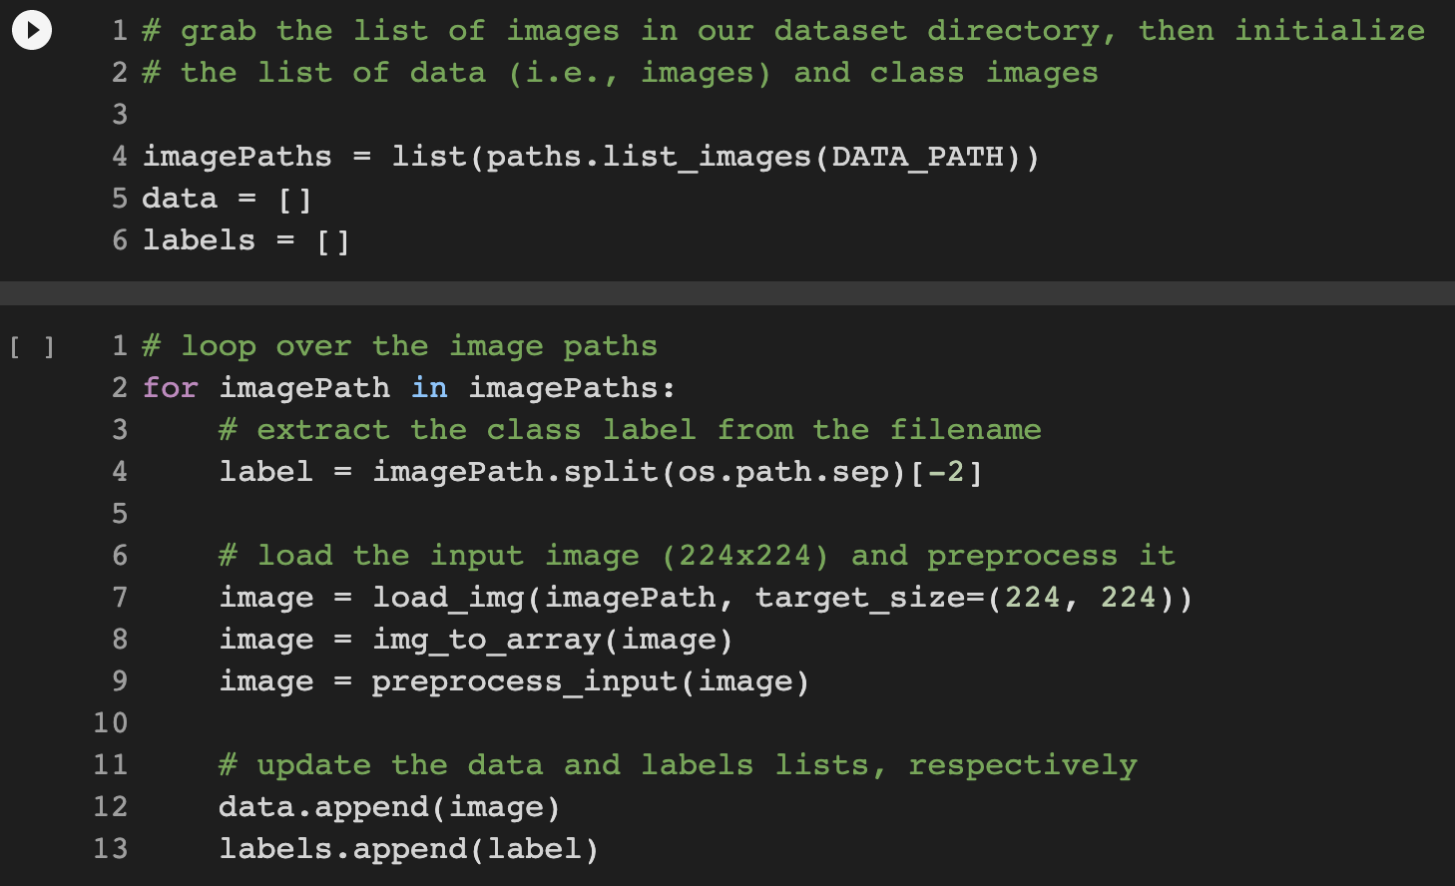
At this point, we’re ready to load and pre-process our training data:
Notes:
Grabbing all of the imagePaths in the dataset (Line 4).
Initializing data and labels lists (Lines 5 and 6).
Looping over the imagePaths and loading + pre-processing images (Lines 2-13). Pre-processing steps include resizing to 224×224 pixels, conversion to array format, and scaling the pixel intensities in the input image to the range [-1, 1] (via the preprocess_input convenience function).
Appending the pre-processed image and associated label to the data and labels lists, respectively (Lines 12 and 13).

Slide 10
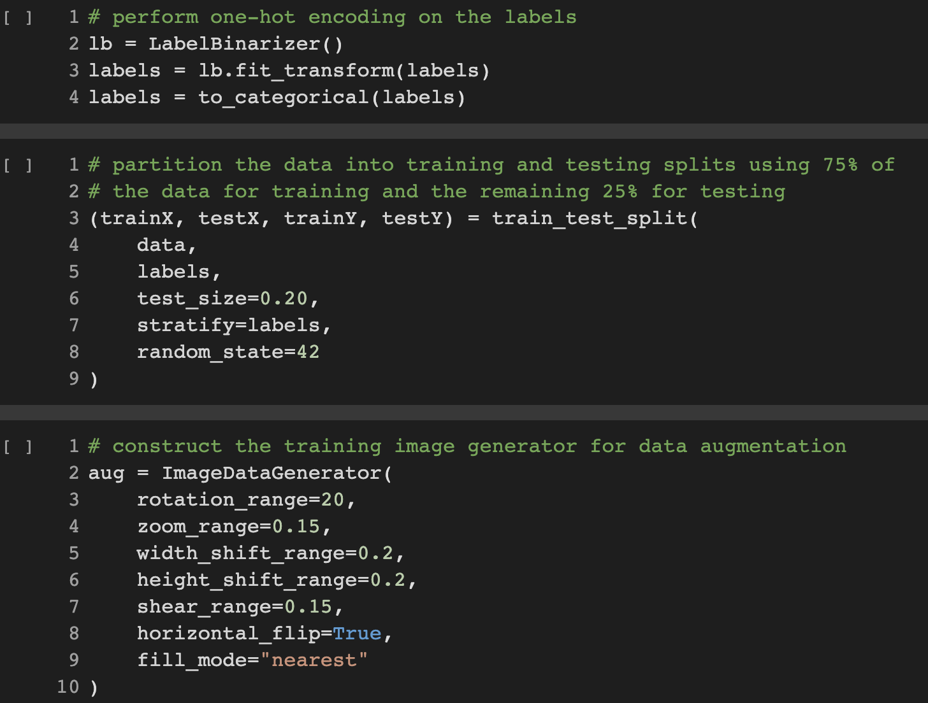
Ｗe’ll encode our labels, partition our dataset
Notes:
Lines 2-4 one-hot encode our class labels.
Lines 3 and 9 segment our data into 80% training and the remaining 20% for testing.
During training, we’ll be applying on-the-fly mutations to our images in an effort to improve generalization. This is known as data augmentation, where the random rotation, zoom, shear, shift, and flip parameters are established on Lines 2-10. We’ll use the aug object at training time.
But first, we need to prepare MobileNetV2 for fine-tuning:

Slide 11
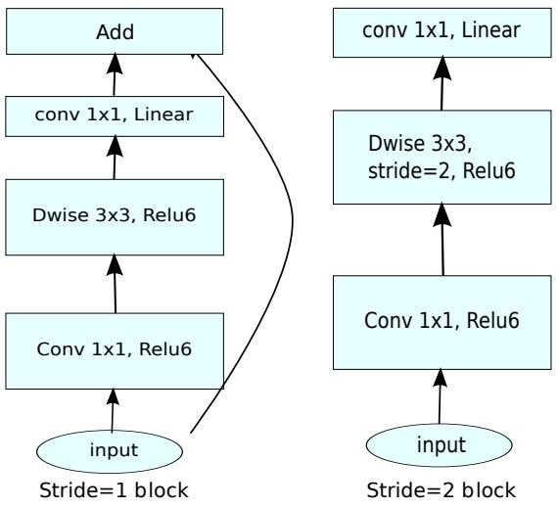
MobileNetV2
In MobileNetV2, there are two types of blocks. One is residual block with stride of 1. Another one is block with stride of 2 for downsizing.
There are 3 layers for both types of blocks.
This time, the first layer is 1×1 convolution with ReLU6.
The second layer is the depthwise convolution.
The third layer is another 1×1 convolution but without any non-linearity. It is claimed that if ReLU is used again, the deep networks only have the power of a linear classifier on the non-zero volume part of the output domain.
https://www.researchgate.net/publication/337970110_IoTNet_An_Efficient_and_Accurate_Convolutional_Neural_Network_for_IoT_Devices
Notes:
So, lets introduce the model we used for training, the MobileNetV2,
as illustrated in figure, builds on the origin MobileNet architecture using 3x3 depth-wise separable convolutions
The different from MobileNetV1 is in MobileNetV2, it add with the addition of an inverted residual structure where shortcut connections are used between thin bottleneck layers to reduce input and output sizes,
Its main purpose is to reduce the computational complexity of the original convolution
in this model outperformed the state-of-the-art networks such as MobileNet and ShuffleNet,at the time for the evaluation of ImageNet

Slide 12
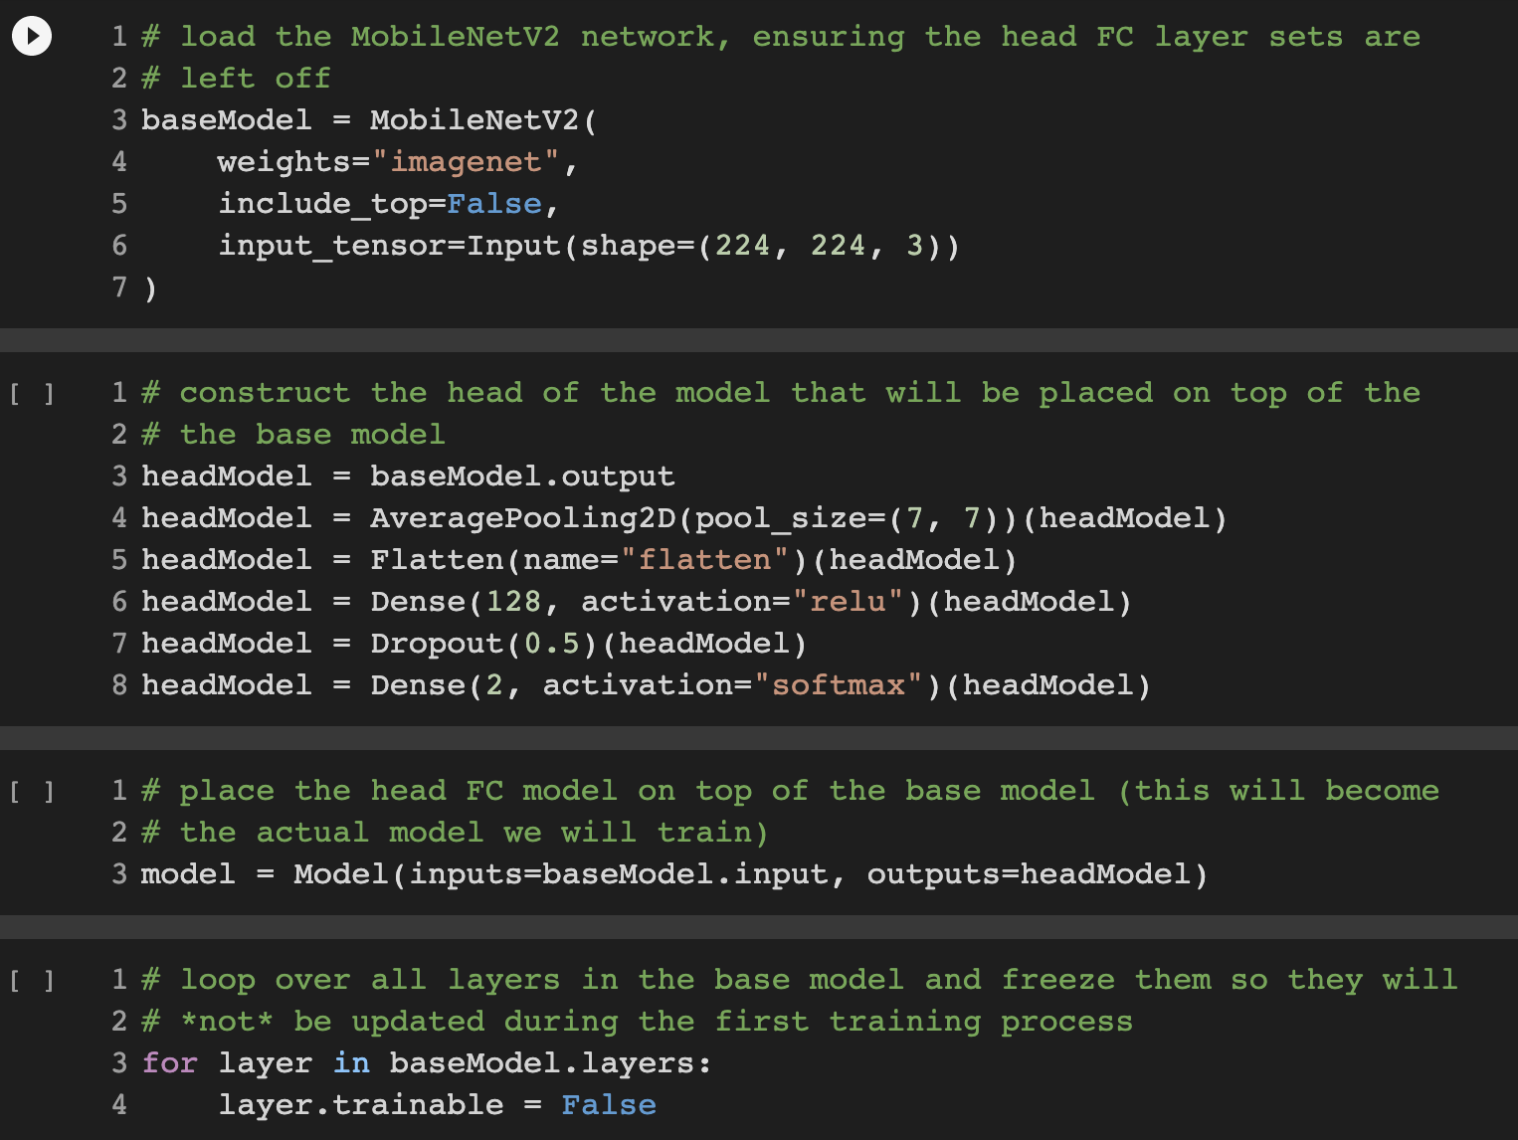
We need to prepare MobileNetV2 for fine-tuning
Notes:
In this project, we used the fine tuning method for tranfer learning
Fine-tuning setup is a three-step process:
[1] Load MobileNet with pre-trained ImageNet weights, leaving off head of network (Lines 3 and 7)
[2] Construct a new FC head, and append it to the base in place of the old head (Second block Lines 3-Third block Line 3)
[3] Freeze the base layers of the network (Lines 3 and 4). The weights of these base layers will not be updated during the process of backpropagation, whereas the head layer weights will be tuned.

Slide 13
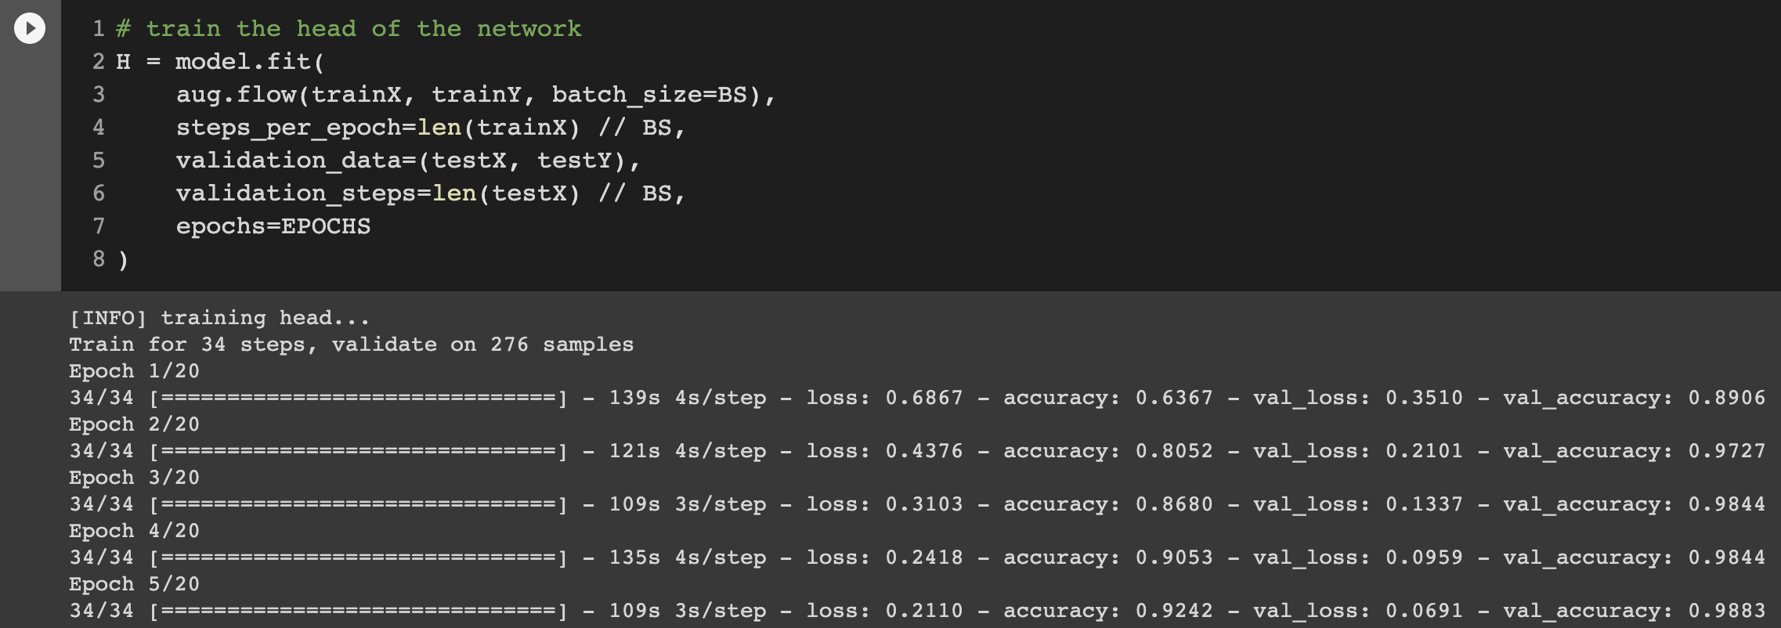
Compile and train our face mask detector network and modeling results
Notes:
With our data prepared and model architecture in place for fine-tuning, we’re now ready to compile and train our face mask detector network:
Face mask training is launched via Lines 2-8. Notice how our data augmentation object (aug) will be providing batches of mutated image data.
Once training is complete, we’ll evaluate the resulting model on the test set.

Slide 14
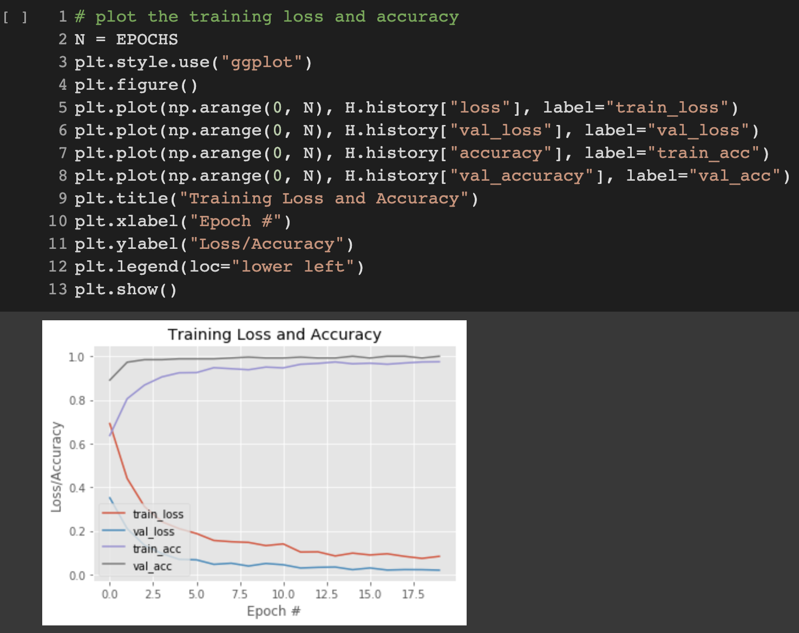
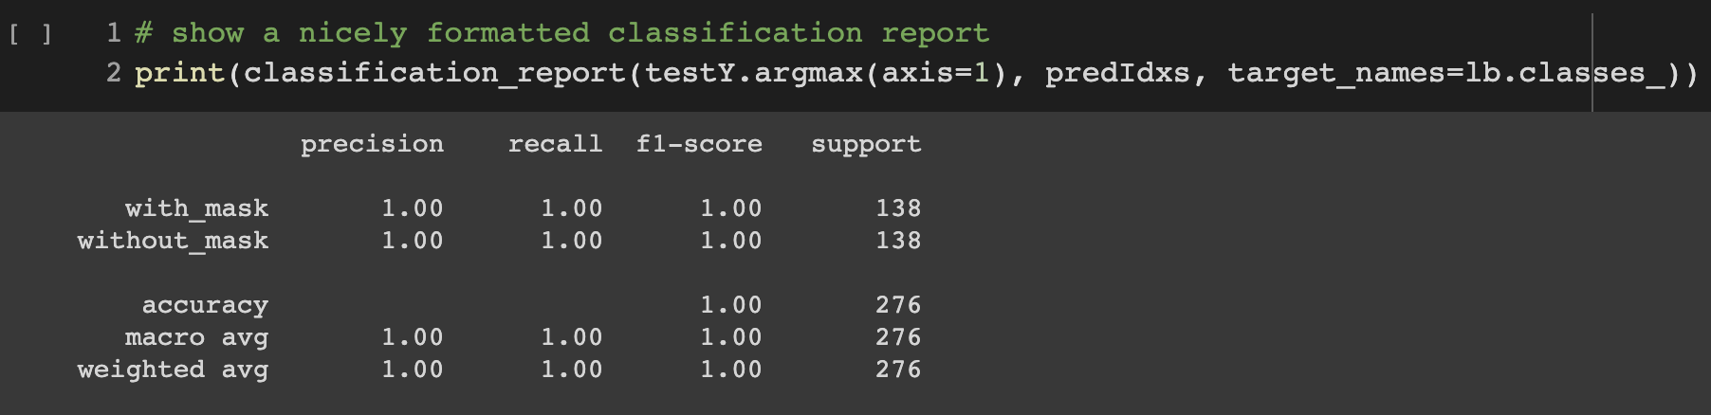
Plot our accuracy and loss curves
Notes:
Our last step is to plot our accuracy and loss curves:
As you can see, we are obtaining ~100% accuracy on our test set.
Face mask detector training accuracy/loss curves demonstrate high accuracy and little signs of overfitting on the data. We’re now ready to apply our knowledge of computer vision and deep learning using Python, OpenCV, and TensorFlow/Keras to perform face mask detection.
Given these results, we are hopeful that our model will generalize well to images outside our training and testing set.

Slide 15
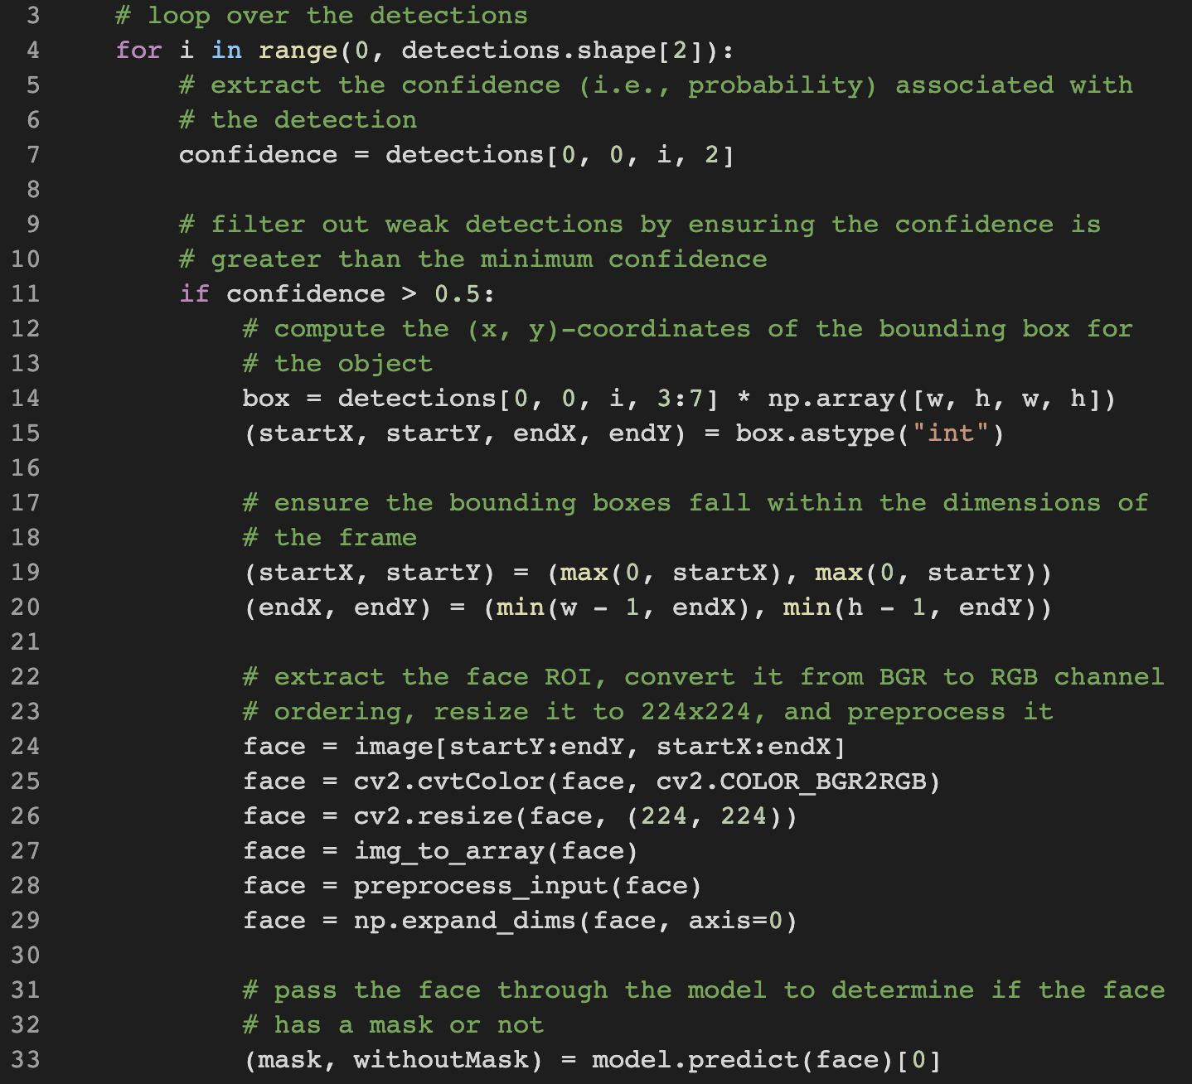
Run the face ROI through our MaskNet model
Notes:
Once we know where each face is predicted to be, we’ll ensure they meet the --confidence threshold before we extract the faceROIs:
Here, we loop over our detections and extract the confidence to measure against the --confidence threshold (Lines 4-11).
We then compute bounding box value for a particular face and ensure that the box falls within the boundaries of the image (Lines 14-20).
Next, we’ll run the face ROI through our MaskNet model:
In this block, we:
Extract the face ROI via NumPy slicing (Line 24).
Pre-process the ROI the same way we did during training (Lines 25-29).
Perform mask detection to predict with_mask or without_mask (Line 33).

Slide 16
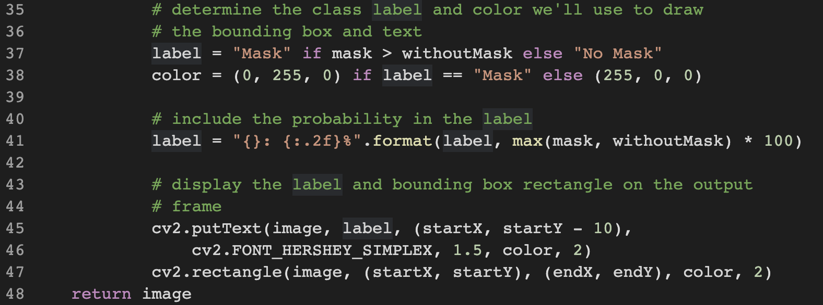
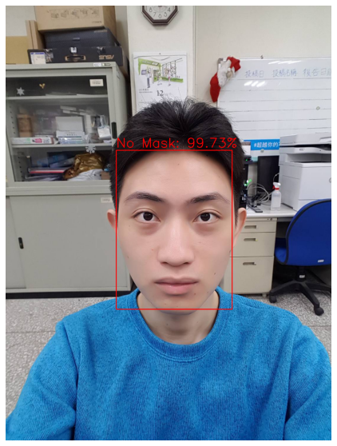
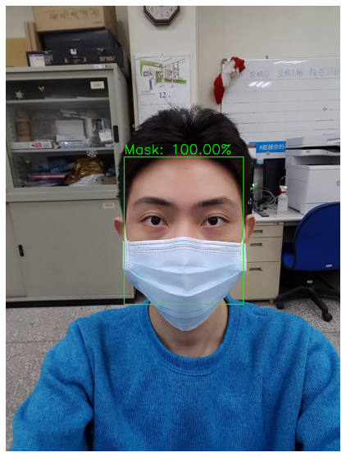
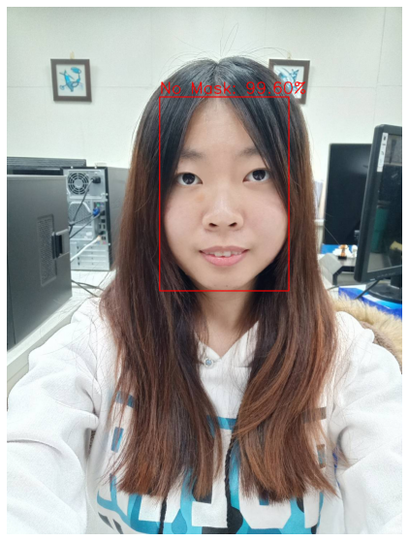
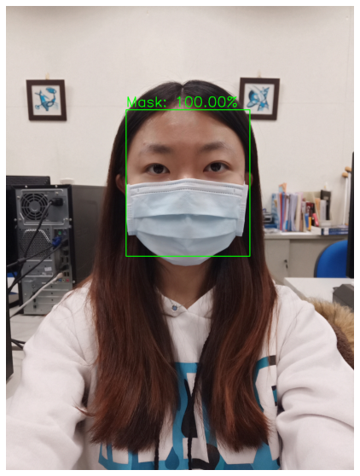
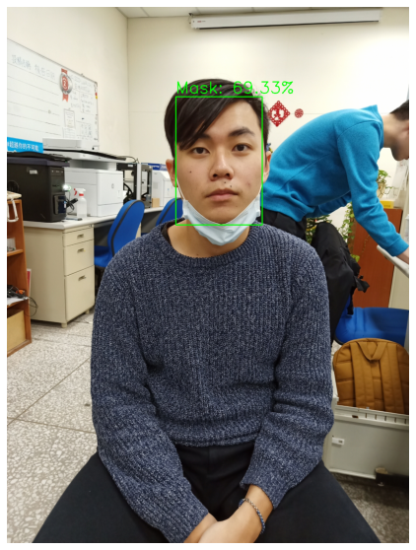
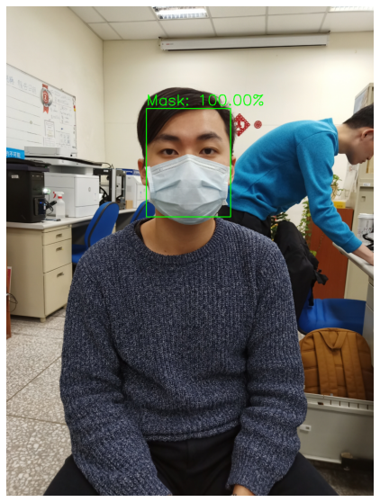
Display the result
Notes:
From here, we will annotate and display the result!
First, we determine the class label based on probabilities returned by the mask detector model (Line 37) and assign an associated color for the annotation (Line 38). The color will be “green” for with_mask and “red” for without_mask.
We then draw the label text (including class and probability), as well as a bounding box rectangle for the face, using OpenCV drawing functions (Lines 45-47).
Once all detections have been processed, Lines 48 return the image.

Slide 17
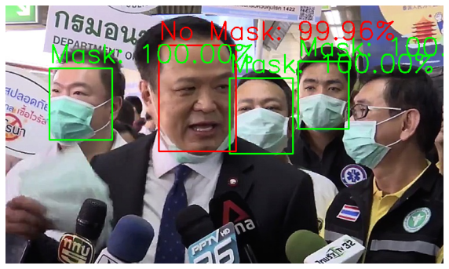
What happened here?
Notes:
What happened here?
Why is it that we were able to detect the faces in the background and correctly classify mask/no mask for them, but we could not detect the male in the rightmost foreground?
The reason we cannot detect the face in the foreground is because:
[1] It’s too obscured by the mask.
[2] The dataset used to train the face detector did not contain example images of people wearing face masks.
[3] The character does not turn to the front.
Therefore, if a large portion of the face is occluded, our face detector will likely fail to detect the face.

Slide 18
Summary
We create a face mask detector using OpenCV, Keras/TensorFlow, and Deep Learning.
We fine-tuned MobileNetV2 on our mask/no mask dataset and obtained a classifier that is ~99% accurate.
In order to classify whether or not a person is wearing in mask, we first need to perform face detection — if a face is not found , then the mask detector cannot be applied!

Slide 19
References
S. Yang, P. Luo, L. C. Change, and X. Tang. Wider face: A face detection benchmark. In IEEE CVPR, pages 5525– 5533, 2016.
S. Yang, P. Luo, C. C. Loy, and X. Tang. From facial parts responses to face detection: A deep learning approach. In IEEE ICCV, pages 3676–3684, 2015.
C. Zhang and Z. Zhang. Improving multiview face detection with multi-task deep convolutional neural networks. In IEEE WACV, pages 1036–1041, 2014.

